Slide 1


Programming Hero
Slide Redesign

Slide 2


INSTRUCTOR
Mezbaul Abedin Forhan
Manager, Programming Hero

Slide 3
INSTRUCTOR
Mezbaul Abedin Forhan
Manager, Programming Hero

Slide 4

What is Typescript
Typescript is an Object Oriented Programming Language that is built on top of JS with Extra Features.

Slide 5
What is Typescript
Level1 extends Level2
Javascript extends Typescript
TS
TS
Level1
JS

Slide 6
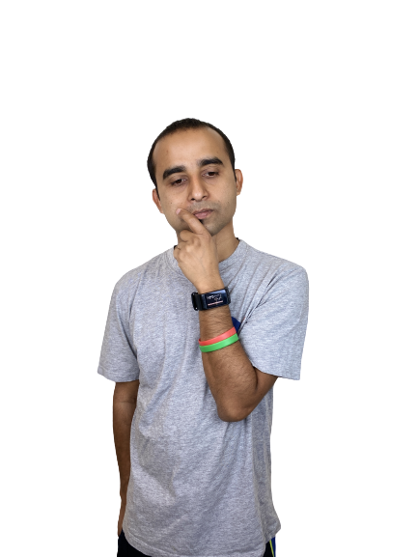
Why Typescript ?

Slide 7

Lackings in JavaScript
Dynamically Typed Language
Difficult to Manage Large Code Base
No Compile Type Check
Does not have built in support for OOP
Difficult to build robust tools like refactoring and autocompletion IDEs.

Slide 8
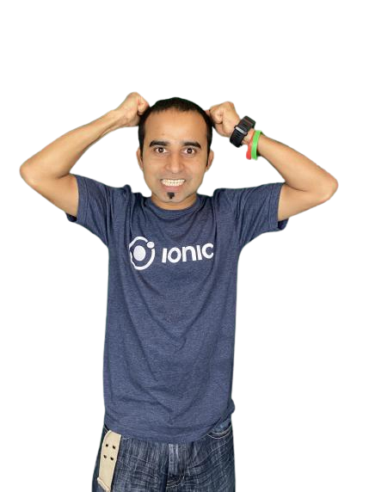
When Working in a Large Application with Multiple Developers
Very difficult to main Large Codebase
Hard to find bugs
Catch errors only in runtime

Slide 9

Need es5 support in older browser
but you like moden syntax ?

Slide 10
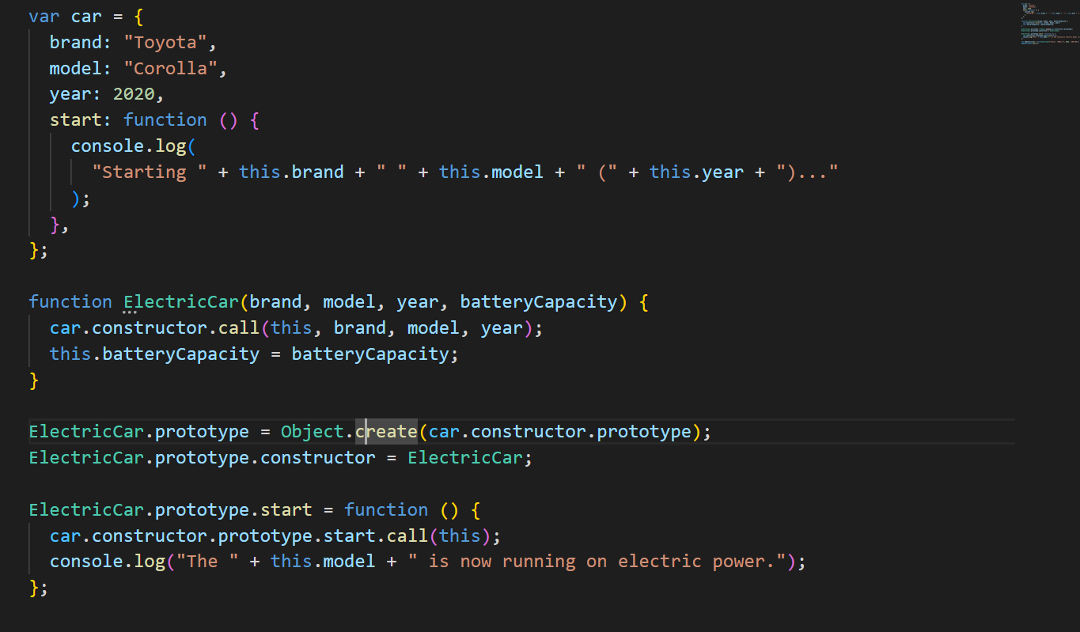


Slide 11
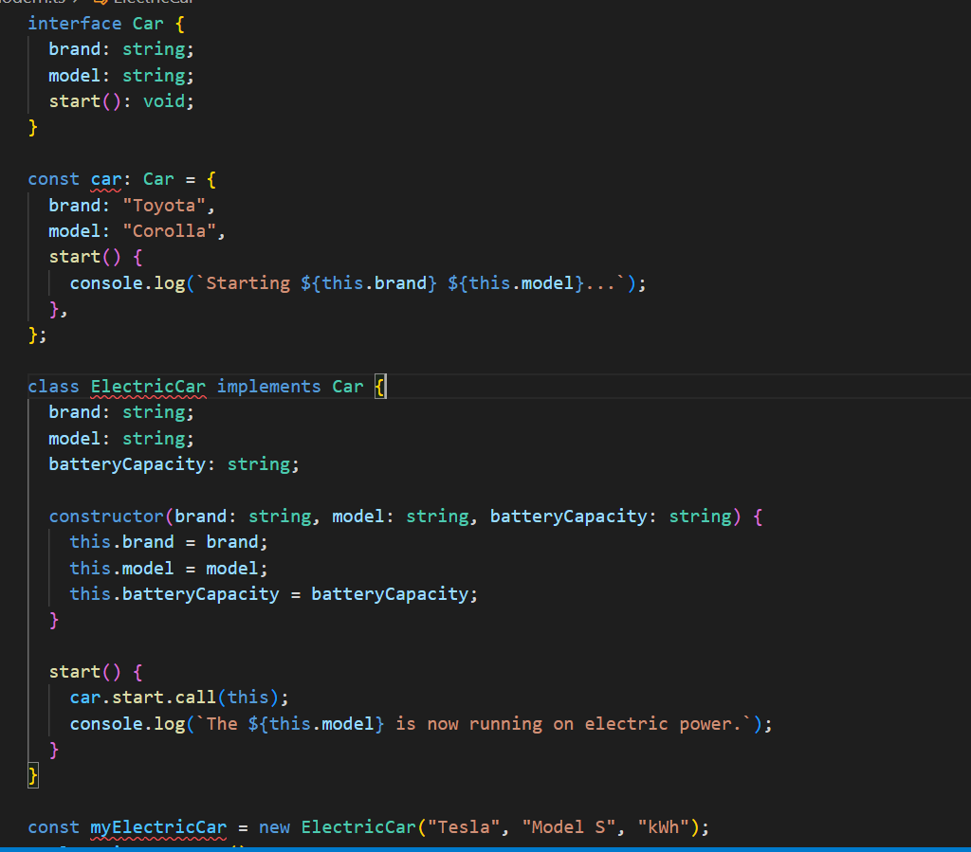

Slide 12


What is Typescript

Slide 13
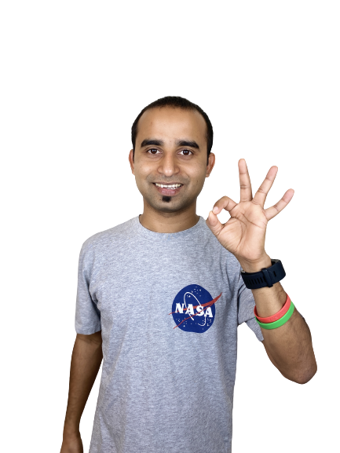
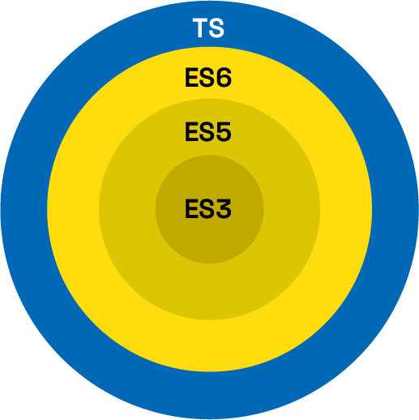
Typescript code can be compiled into older versions of Javascript

Slide 14

Benefits of Using TypeScript
Supports Older Browser
Type safety
Increase Your Productivity
Less Bugs and Less Testing

Slide 15
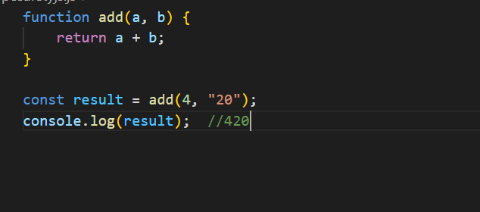
Benefits of Using TypeScript
Type safety

Slide 16
Benefits of Using Typescript
ype safety

Slide 17
Benefits of Using Typescript
JS Types in TS
Number
String
Boolean
Null
Undefined
Oject
Symbol

Slide 18
Benefits of Using Typescript
JS Types in TS
TS Own Types
Number
String
Boolean
Null
Undefined
Oject
Symbol
Interface
Void
Array
Tuple
Enum
Union
Intersection

Slide 19
Benefits of Using TypeScript
Supports Older Browser
Type safety
Increase Your Productivity
Less Bugs and Less Testing

Slide 20
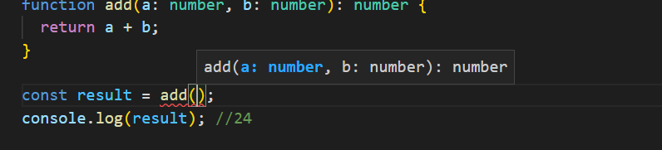
Benefits of Using Typescript

Slide 21
Benefits of Using TypeScript
Supports Older Browser
Type safety
Increase Your Productivity
Less Bugs and Less Testing

Slide 22

Comparison
Dynamically typed
Interpreted
Limited Rich Tooling Support
Can be challenging to manage and maintain large codebases
Static typed
Compiled
Rich Tooling Support
Easy to manage and maintain large codebases

Slide 23
Thank You!
Do you have any question?

